Slide 1
Email Etiquette
Do’s and Don’ts

Slide 2
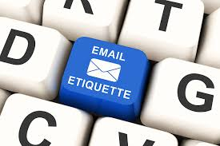
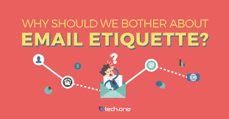
The Importance of Email Etiquette
-How you interact with faculty members and professors over email is very important.
-The way you compose an email can determine how the person responds.
-There are many elements necessary to create a business-like email.
-You should always check your syllabus to make sure your emails to your professor match his/her specific guidelines for emails.
-Here are some do’s and don’ts necessary for email etiquette.

Slide 3
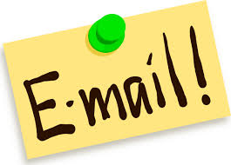
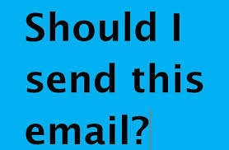
Do’s
-Make sure to be specific in your subject line. Include what the email is regarding and your specific class with your section number. The section number can be found on your syllabus or on D2L Brightspace where you can see all your current classes listed
-Use a respectful greeting
-Be organized and use a formal tone
-Be clear with your questions
-Be sure to say please and thank you

Slide 4
Do’s
-Conclude with a salutation
-Sign the email with your name - not a nickname
-Include your student ID number found on the back of your
Lone Star student ID

Slide 5
Don’ts
-Do not email a professor from any other email except your student email
-Do not expect them to recognize you just by name
-Do not use texting language or contractions
-Do not sign an email with a nickname
-Do not write a long-winded email
-Do not be vague
-Do not forget to proofread

Slide 6
D2L Email
-Make sure to check your syllabus for your professor’s preferred method of communication.
-Your student email address and your D2L email address are different.
-Here is a link that provides step by step instructions regarding how to navigate your D2L email:
https://www.lonestar.edu/departments/lsconline/ST-D2L_Email_for_StudentsV2.pdf

Slide 7
Wrong Email Format
Subject: Hey
I am working on our current assignment and the syllabus is no help. What kind of sources do ya want? And where do you want me to find them. Hopefully you answer soon. By the way I only have a few days to finish it! 😀
J

Slide 8
Correct Email Format
Subject: English 1301 2858 Research Paper Sources
Dear Professor James,
I am seeking clarification regarding the Research Paper assignment. How recent do my sources need to be? Also, are you looking for a specific kind of source, such as journal, magazine, or newspaper articles? Thank you in advance.
Sincerely,
Jane Smith
Student ID #0123456

Slide 9
Important Things to Remember
- Always remember that your emails need to have a formal tone
-You are not emailing your best friend, you are emailing a professor or a faculty member
-Email Etiquette is something you will use for the rest of your life, NOT just in college
-Do not be afraid to contact your Professor

Slide 10
Correct Email Format
Subject: English 1301 2858 Research Paper Sources
Dear Professor James,
I am seeking clarification regarding the Research Paper assignment. How recent do my sources need to be? Also, are you looking for a specific kind of source, like journals, magazines, or newspaper articles? Thank you in advance.
Sincerely,
Jane Smith Student ID #0123456

